Slide 1
Mobile tower maintainance

Slide 2
We want to build an Recruitment and HR system with following features
Authenticate Technicians.
A technician should be able to close, register , reassign a maintenance request.
Technician should be able to send / receive/ alerts and notifications
There should be a complete log track of the MR. The live updates should flow from technician to the corporate office.
Reporting
Should be able to handle high volume of data and transactions

Slide 3
Process Part1
Create System which will use for Mobile tower maintainance.
Authenticate Technicians with help of user id and password.
Give Roles and Rights(Validation Process) to Technicians for close, register , reassign a maintenance request.
Arrange Data in DB(SQL,MySQL,PostGressSQL) for every round of close, register , reassign a maintenance request.
Able to handle alert process also like(after complete task he should be able to send notification like (mail, message)) .

Slide 4
Process Part2
After complete job or maintenance Technicians should be update progress report of that particular task.
Reporting and Logging.

Slide 5
Business Flow And Organization Structure
Business Flow Module and Organization Structure

Slide 6
Business Flow
Request Come
Assign Request By Admin
Get Request In Technician Bucket/Send Email Notification to Technician
Login
By Technician
Authentication Process
Get assign task and work on it
Update Status of task( In progress, Complete, new, Stucked)
Send Mail/Notification Regarding Task
Maintain Log In system
Reporting

Slide 7
Business Flow Description
Getting Request From Admin Request Center.
Authenticate Technicians with proper user id and password and generate oauth token.
With help of this token we are validate every API and give access rights to that’s user for further activity.
Admin should assign maintenance request to Technicians and once he is assign then he got email notification.
Technicians able to view technical request as well as close, register , reassign a maintenance request.
After that he also able to send notification.
Report and Analysis of Mobile tower maintenance system.

Slide 8
Organization Structure
CEO
CEO
CEO
Request Admin
Human Resource
Customer Request
Information Technology
Technicians

Slide 9
Data Flow Scope And Out OF Scope
Data Flow Diagram and Organization Boundary.

Slide 10
Data Flow Scope And Out Scope
Organization Boundary(Scope).
Request Admin Management .
System User Management.
Login Management.
Role Management.
Report Management
Alert and Notification Management
Logging Management
Transaction Management
Out Of Scope Modules.
Hardware And Maintenance Of tower.
Salary Management .
Leave Management.

Slide 11
Zero Level Data Flow Diagram
Admin Request Management
Transaction Management
System User Management
Technicians
Logging Management
Login Management
Alert and Notification Management
Role Management
Report Management

Slide 12
First Level Data Flow Diagram
Admin Request Management
Admin Request Report
System User Management
System User Report
Login Management
HR
Check Login Details
Role Management
Role and Resposiblity Report
Report Management
Generate Other and Self Report
Alert and Notification Management
Alert and Notification Report
Logging Management
Log Report
Transaction Management
Transaction Details

Slide 13
Second Level Data Flow Diagram
Login To System
Check Role Access
Admin Request Details
Request Admin
System User Details
Forgot Password
Manage Maintenance Details
Manage Module
Manage Role Details
Check Credential
Manage Alert and Notification Details
Send Email To User
Logging Details
Manage User Permission
Manage Reports
Transaction Of User

Slide 14
Technical Flow Chart
Technical Flow Chart of Mobile tower maintenance

Slide 15
Technical Flow Chart
Filter Maintained task And Distribute
Is Task Is In Progress
Get All maintenance task
Start
No
Is Anywhere Stacked
Yes
Is task Complete
No
No
Yes
Yes
A
Is task Complete
Yes
Send Mail
Report
No

Slide 16
Technical Flow Chart
A
Task Admin
Report
Send mail
Follow-up
Complete task
Send Notification To Client
End

Slide 17
Architecture Diagram
Level And Architecture

Slide 18
Code Level Architecture(3 Tier)
Presentation Tier (Asp.Net,Razor,AngulerJs,Html)
Business Tier(C# Classes and Compute)
Data Tier(SP and Sql Server)
Sql Server(Data)

Slide 19
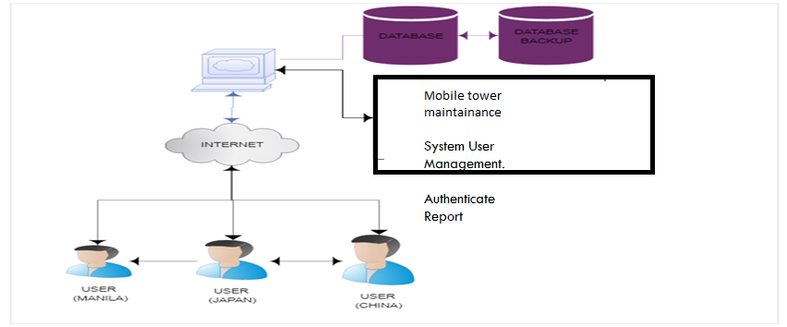
High Level Architecture Diagram

Slide 20
Detail Level Architecture Diagram
DNS
User Browser
CDN
Data Ware House
Cloud Storage
Load Balancer
DB
Web App Server
Fir
Data Fire House
Queue
Cashing Server
Job Server
Full Text Search Services
Services

Slide 21
Web Application Server
At a high level web application servers are relatively simple to describe. They execute the core business logic that handles a user’s request and sends back HTML to the user’s browser. To do their job, they typically communicate with a variety of backend infrastructure such as databases, caching layers, job queues, search services, other micro services, data/logging queues, and more. As mentioned above, you typically have at least two and often times many more, plugged into a load balancer in order to process user requests.

Slide 22
Load Balancer
Before diving into details on load balancing, we need to take a step back to discuss horizontal vs. vertical application scaling. What are they and what’s the difference? Very simply horizontal scaling means that you scale by adding more machines into your pool of resources whereas “vertical” scaling means that you scale by adding more power (e.g., CPU, RAM) to an existing machine.
In web development, you (almost) always want to scale horizontally because, to keep it simple, stuff breaks. Servers crash randomly. Networks degrade. Entire data centers occasionally go offline. Having more than one server allows you to plan for outages so that your application continues running. In other words, your app is “fault tolerant.” Secondly, horizontal scaling allows you to minimally couple different parts of your application backend (web server, database, service X, etc.) by having each of them run on different servers. Lastly, you may reach a scale where it’s not possible to vertically scale any more. There is no computer in the world big enough to do all your app’s computations. Think Google’s search platform as a quintessential example though this applies to companies at much smaller scales..
load balancers, They’re the magic sauce that makes scaling horizontally possible. They route incoming requests to one of many application servers that are typically clones / mirror images of each other and send the response from the app server back to the client. Any one of them should process the request the same way so it’s just a matter of distributing the requests across the set of servers so none of them are overloaded.

Slide 23
DNS
DNS stands for “Domain Name System” and it’s a backbone technology that makes the world wide web possible. At the most basic level DNS provides a key/value lookup from a domain name (e.g., google.com) to an IP address (e.g., 85.129.83.120), which is required in order for your computer to route a request to the appropriate server

Slide 24
Database Server
Every modern web application leverages one or more databases to store information. Databases provide ways of defining your data structures, inserting new data, finding existing data, updating or deleting existing data, performing computations across the data, and more. In most cases the web app servers talk directly to one, as will the job servers. Additionally, each backend service may have it’s own database that’s isolated from the rest of the application.
There are following DB used in our applications
SQL , MONGODB, REDIS

Slide 25
Caching Service
A caching service provides a simple key/value data store that makes it possible to save and lookup information in close to time. Applications typically leverage caching services to save the results of expensive computations so that it’s possible to retrieve the results from the cache instead of recomputing them the next time they’re needed. An application might cache results from a database query, calls to external services, HTML for a given URL, and many more.
In our application we are using REDIS Cache Or REDIS Cluster.

Slide 26
Job Queue & Servers
Most web applications need to do some work asynchronously behind the scenes that’s not directly associated with responding to a user’s request. For instance, Google needs to crawl and index the entire internet in order to return search results. It does not do this every time you search. Instead, it crawls the web asynchronously, updating the search indexes along the way.
While there are different architectures that enable asynchronous work to be done, the most ubiquitous is what I’ll call the “job queue” architecture. It consists of two components: a queue of “jobs” that need to be run and one or more job servers (often called “workers”) that run the jobs in the queue.

Slide 27
Elasticsearch
Many if not most web apps support some sort of search feature where a user provides a text input (often called a “query”) and the app returns the most “relevant” results. The technology powering this functionality is typically referred to as full-text search, which leverages an inverted index to quickly look up documents that contain the query keywords.
Example showing how three document titles are converted into an inverted index to facilitate fast lookup from a specific keyword to the documents with that keyword in the title. Note, common words such as “in”, “the”, “with”, etc. (called stop words), are typically not included in an inverted index. While it’s possible to do full-text search directly from some databases (e.g., MySQL supports full-text search), it’s typical to run a separate “search service” that computes and stores the inverted index and provides a query interface. The most popular full-text search platform today is Elasticsearch.

Slide 28
Cloud storage
“Cloud storage is a simple and scalable way to store, access, and share data over the Internet” according to Azure. You can use it to store and access more or less anything you’d store on a local file system with the benefits of being able to interact with it via a RESTful API over HTTP.
There are multiple option on AZURE (BLOB and FileStorage)

Slide 29
CDN (Content Delivery Network)
CDN stands for “Content Delivery Network” and the technology provides a way of serving assets such as static HTML, CSS, Javascript, and images over the web much faster than serving them from a single origin server. It works by distributing the content across many “edge” servers around the world so that users end up downloading assets from the “edge” servers instead of the origin server. For instance in the image below, a user in Spain requests a web page from a site with origin servers in NYC, but the static assets for the page are loaded from a CDN “edge” server in England, preventing many slow cross-Atlantic HTTP requests.

Slide 30
Conceptualizing solution
Conceptualizing solution

Slide 31
Conceptualizing solution OF Tech Flow
Request
Response
Validation
Filters
DBML
WEB API
WCF Service
Proxy Server
Data Structure
OOPS( Reusability )
SOLID
Patterns
ADF(Azure Data factory)
Azure Blob Storage
Azure Web App Service
Azure Load Balancer
Azure CDN Service
Azure Backup Service
Elastic Search
DB Fragmentation
DB Shading
MASTER-SLAVE Replication

Slide 32
Key Solution High Lights
Key Solution and Uses

Slide 33
Key Solution Highlights
Security
Application security is the process of making apps more secure by finding, fixing, and enhancing the security of apps. Much of this happens during the development phase, but it includes tools and methods to protect apps once they are deployed.
Flexibility
Flexible to increase/Decrease instance size.
Disaster Recovery
Scalability
Vertical Scale Up
Horizontal Scale Up
High Availability
99.9 Percent of chance of availability.
High Tenancy
Very fast access site with help of DNS and CDN
Easy To maintain

Slide 34
Deployment Diagram
Content Flow Describe And Deployment , Delivery Model

Slide 35
Content Flow Description
A content author(User) creates content(Insert,update Data) in staging, which is stored in the staging database. On site sync, data is pulled from the database and transferred to the production server, which in turn stores the content in the production database.

Slide 36
Content Flow Diagram
Production DB
Staging DB
Computer
Prod Server
Staging Server
Save Data, Search data
Data Sync

Slide 37
Code flow deployment strategy and Model
Locale
Source Control
Dev
Staging
Prod
Check In
Test Failed
Check In
Test Passed
Trigger Deployment
Test Passed
Promotion
Test Passed
Promotion

Slide 38
Development And Deployment Plan
Requirement gathering
Testing and Regression
Product Manager
Error Then assign Bugs
BI
Tech Lead/Tech Manager
Regression and then Move To Stage
Story Writing
Assign To Developer
Show demo To Client and Manager
Set Priority
Assign to QA Environment
Move To Prod and Test
Sprint Planning and Ready For Dev Stories
QA
Sprint Retro

Slide 39
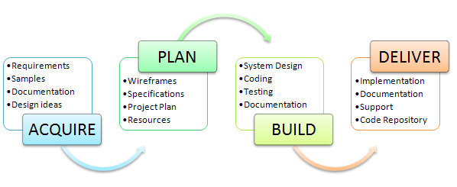
Delivery Model

Slide 40
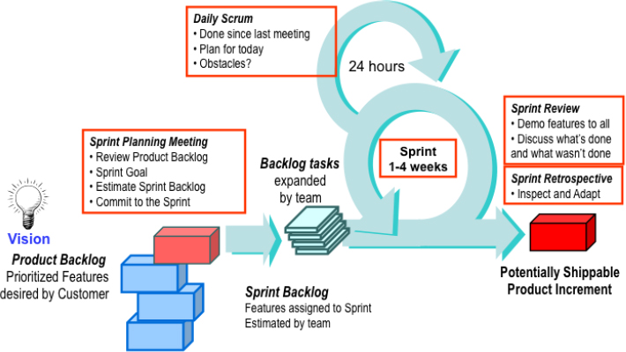
Development Model (Scrum)

Slide 41
DB Diagram
DB Diagram

Slide 42
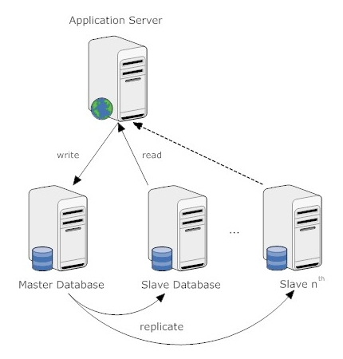
DB Architecture

Slide 43
DB Diagram (Candidate DB )
Technicians |  | SkillMaster |  | SkillTechMapping
TechId |  | SkillId |  | SkillTechMappingId
Fname |  | SkilName |  | TechId
Lname |  |  |  | SkillId
Contact
Email
RoleId
UserId
Password
Task |  | StatusMaster |  | RoleMaster
TaskId |  | StatusId |  | RoleId
TaskName |  | StatusCode |  | RoleName
TaskStartDate |  | StatusName
TaskEndDate
TaskDescription
StatusId
IsSendNotification
Reason

Slide 44
Component Diagram
Component Diagram

Slide 45
Component Diagram
Task Admin
Task Generation
Security
Mobile Maintenance System
Validate task
Persistence
Work on task and Update
Notification
DB
Report

Slide 46
Application Software Usage
Before Login Screen , After login Screen

Slide 47
Software Uses
Dot Net
Linq
Wcf
WebApi
Azure Cloud Storage(VM,Scale,ADF,CDN,SQL,Traffic Manager)
Design Pattern
Exception Handling Using Sentry
Google Pub Sub
CMS
C#,Ado DotNet
Redis Cache
DBML
SP
MVC
Monolythic
Windows Service
Anguler
SQL Server
Sentry
MongoDB
PUB SUB
BI Tools

Slide 48
WEB Screens
HR and Recruitment Screens

Slide 49
Design Before Login
Login Page
User Name
Password
Login

Slide 50
Pseudo Code (Sample Code Write)

Slide 51
Design After Click On Add/Edit task Widget
Task Id
Task Name
Start date
End date
Description
Status
Complete
In progress
Stacked
New
Reason
Submit

Slide 52
Design After Click On Edit Widget
Task Id | Task Name | Status | Description | Reason | View /Edit/Send Notification
Submit

Slide 53
Report
Start date
Go
End date
Status
Task Id | Task Name | Status | Description | Reason | Start date/End date

Slide 54
Design After Login ( Admin Widget )
Report
Create/Update Login
Add/Update New Technicians
View And Edit Details of Technicians

Slide 55
Design After Login ( Task Admin Widget )
Report
Assign Task
View/Edit Details of Task
Follow-up On task
View/Edit status of task
Notification
Customer Update
Close/register/ reassign Task

Slide 56
Design After Login (TechniciansWidget )
Self Report
Task Report
Other Tecnicians Report
Pending Task Report
View/Edit Details of Task
Send Notification
Update to Task Admin
Close/register/ reassign Task

Slide 57
Thanks You

